Slide 1

GOD
Adult Education
Health care
Blind Centre
Disaster Relief
Living Evangelism Outreach Ministries/ Evangelical Church of Pakistan
Struggling those who desire life in life
livingevang07@gmail.com

Slide 2
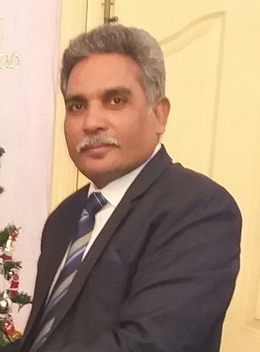
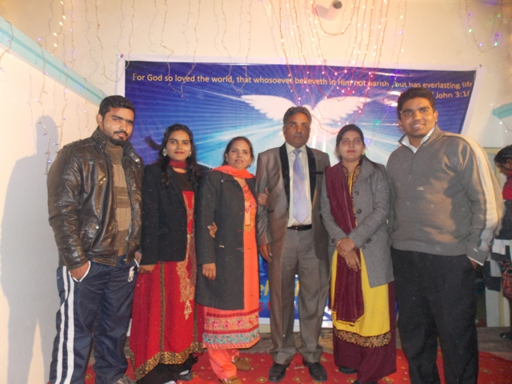
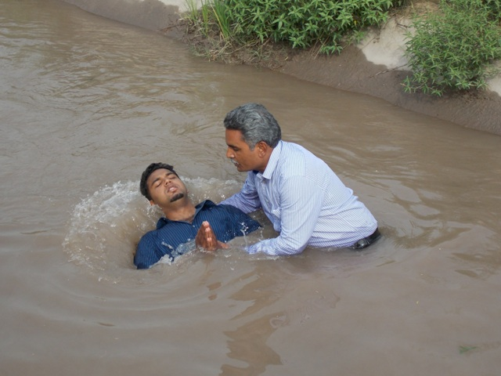
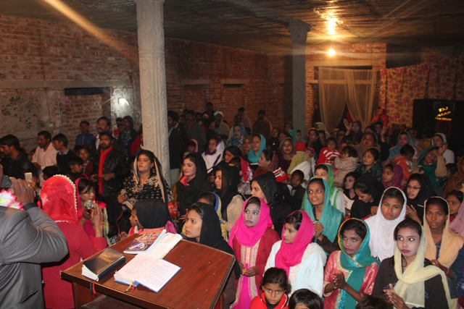
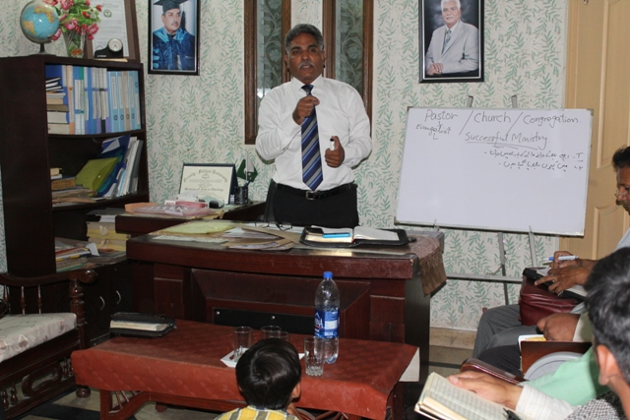
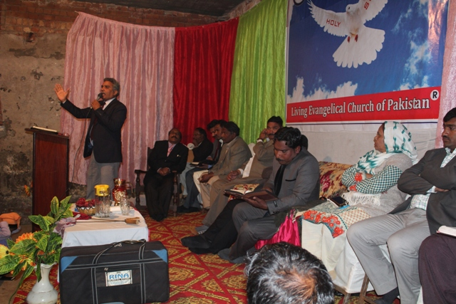
Pastor Samuel Sadiq
Founder & Chairman
Family Photo
Pastor Samuel Sadiq is ministering at village Mustifabad district Kasur as Senior pastor since 2004 with 45 families. The church building is under
construction and praying for completion.

Slide 3
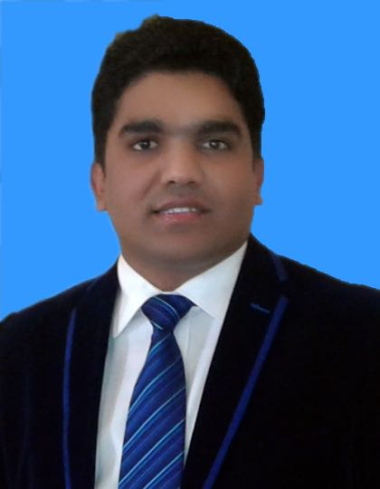
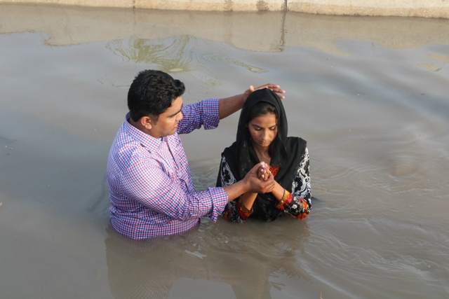
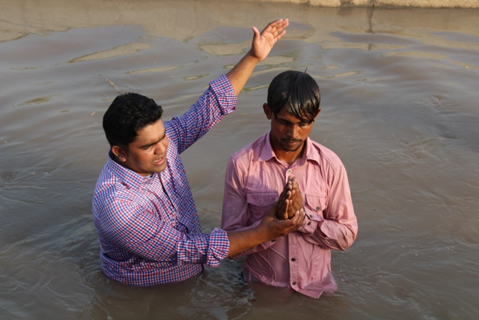
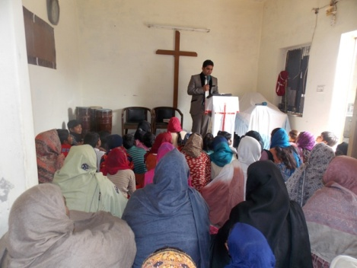
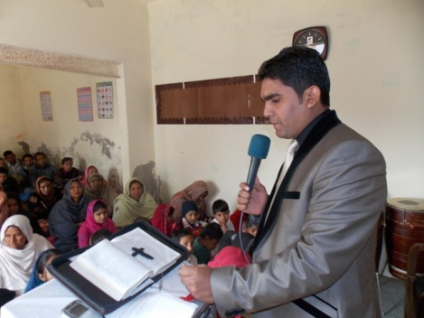
Pastor Sunil Samuel Bachelor)
Pastor Sunil Samuel serving at LEOM as National Director since 2010 and ministering at Hurbanspura, district Lahore and there are 25 families worshiping the God in a rented Building.

Slide 4
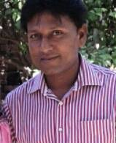
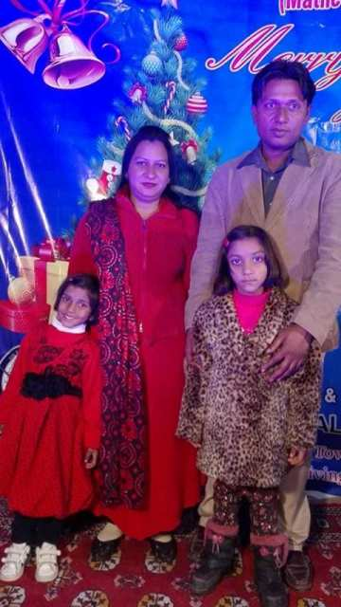
Pastor Yaqoob Francis
Family photo
Yaqoob Francis serving full time in ministry since 2015 at village “Sardar Town” , Rawind Road district Lahore . There are 30 families and worship the God in a house. There is no church building.

Slide 5
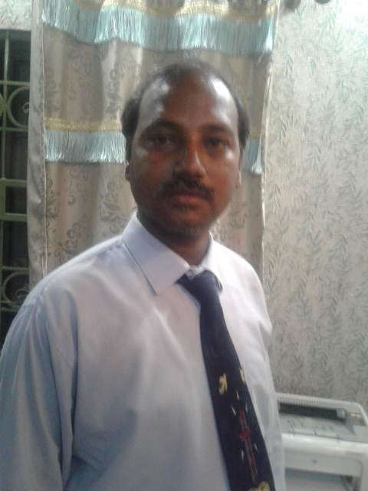
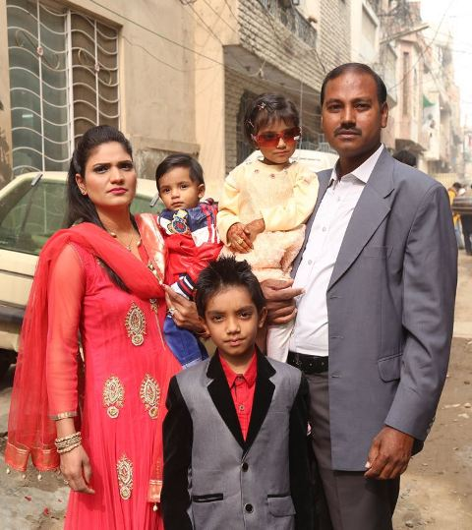
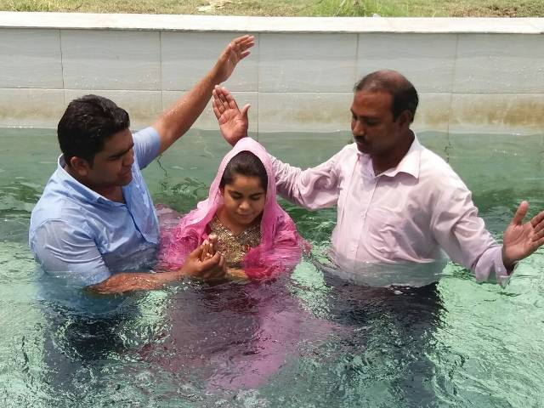
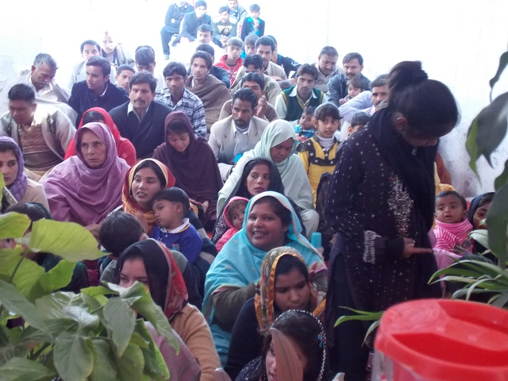
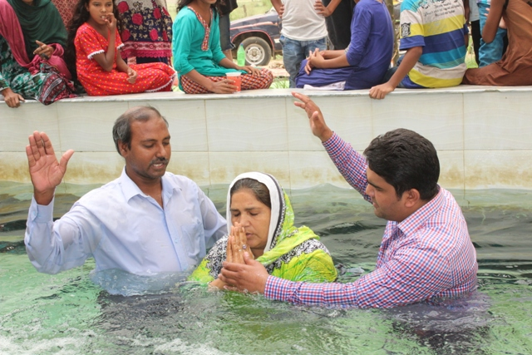
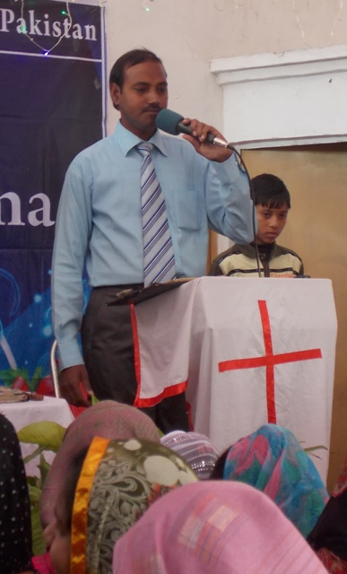
Pastor Amjad Anwar is serving at village Gohawa, district Lahore since 2010 with 23 families in a rented building. We are praying for the church building.
Pastor Amjad Anwar & family

Slide 6
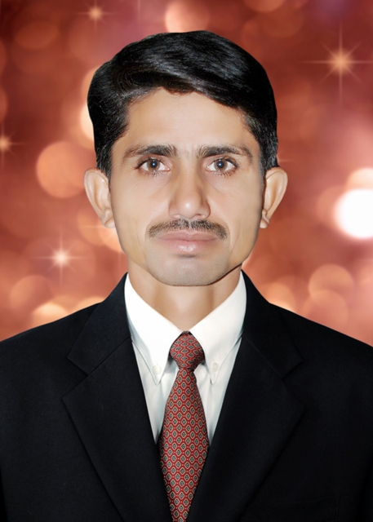
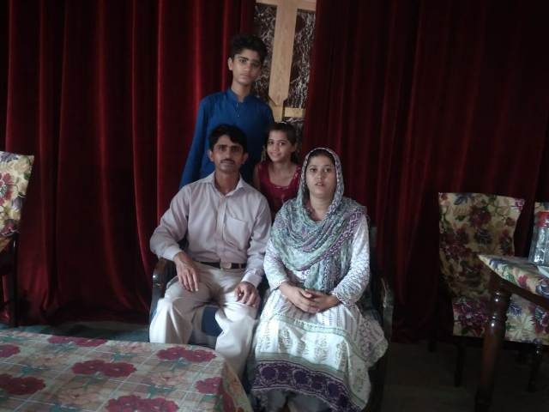
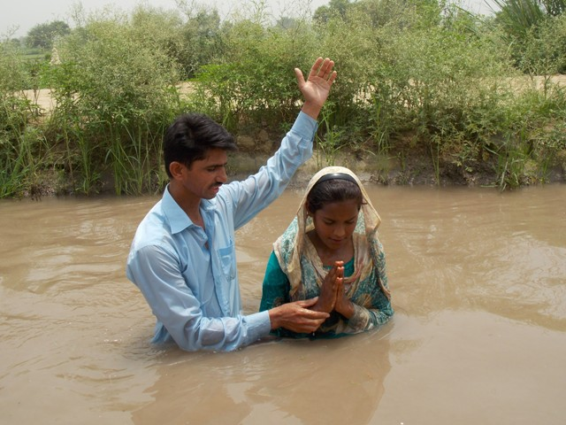
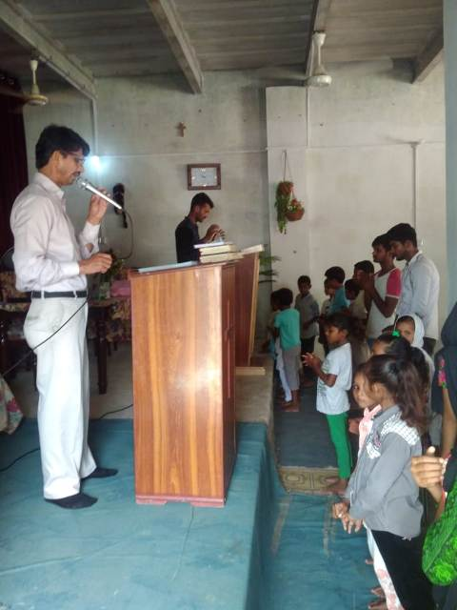
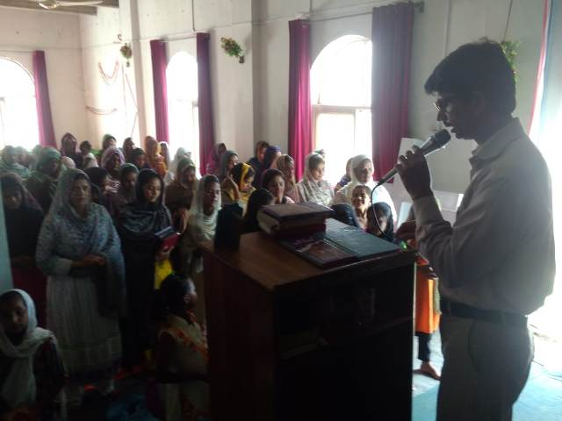
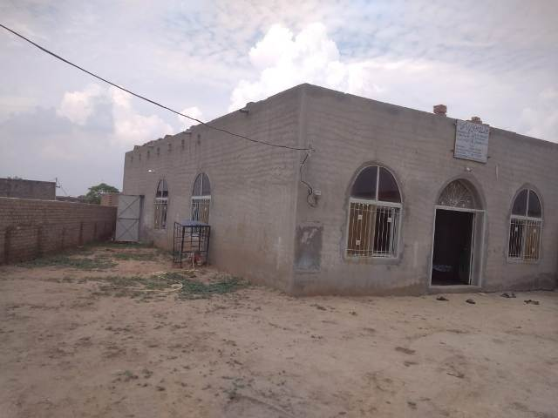
Pastor Parvaiz Ashiq & Family
Pastor Parvaiz Ashiq is serving at village Gaga district Lahore since 2007.There are 42 families worshiping the God in a church building. Last Year 2017 we completed the church building.

Slide 7
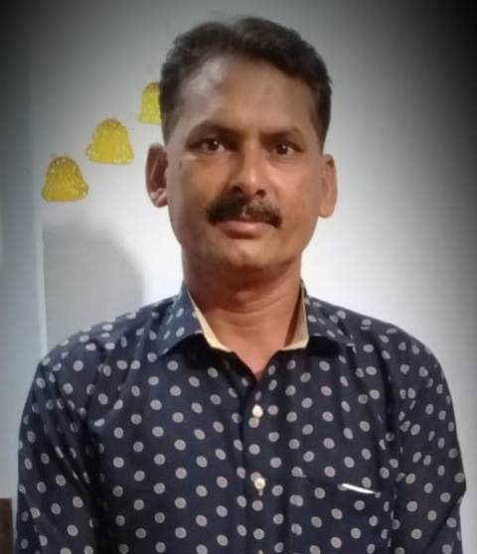
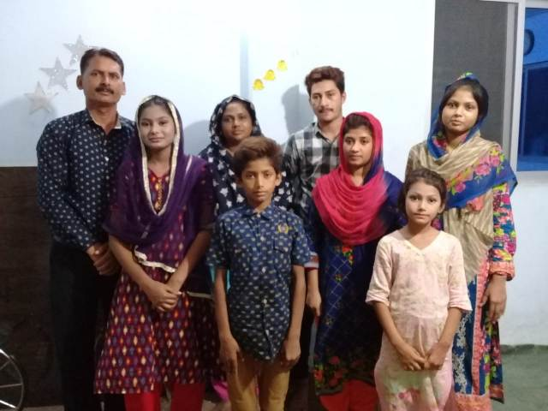
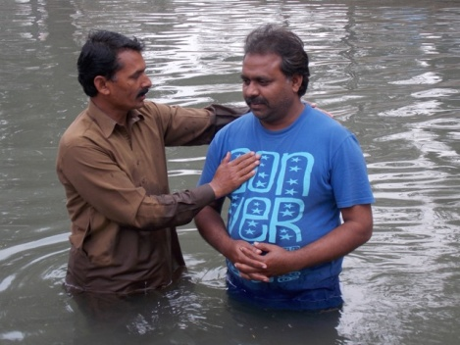
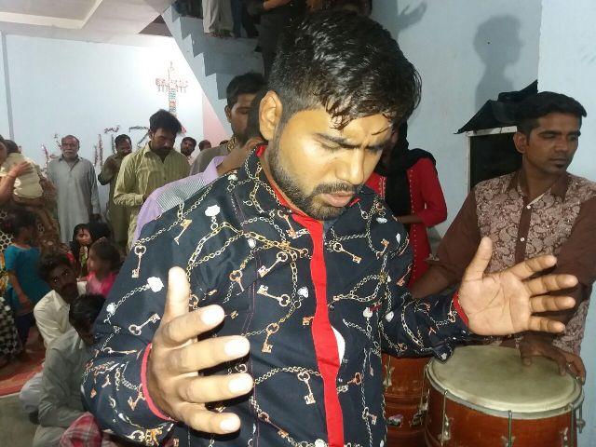
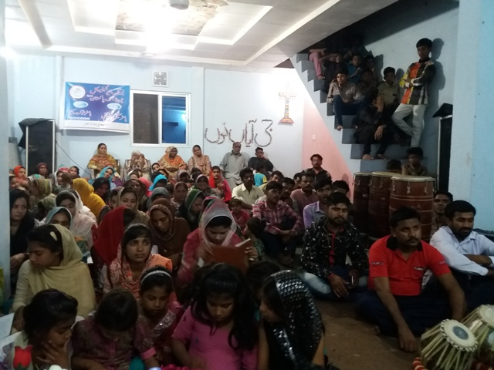
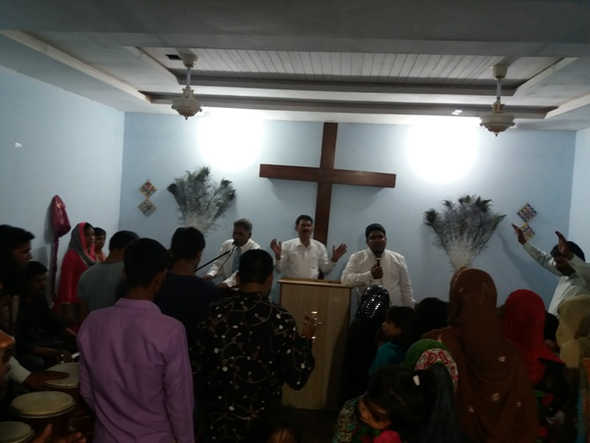
Pastor Shoukat Masih & family
Pastor Shoukat Masih ministering at “ Nawab pura” district Lahore and have 28 families worshiping the God in a rented Building since 2014.

Slide 8
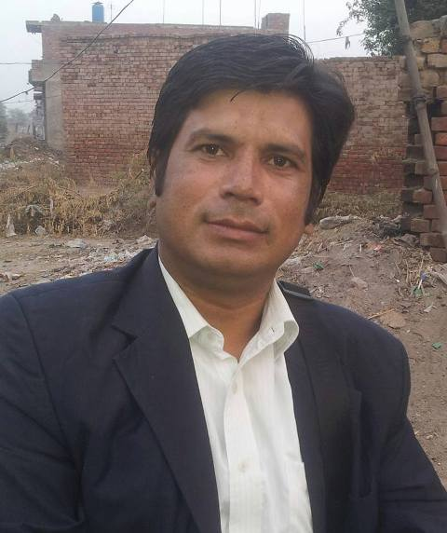
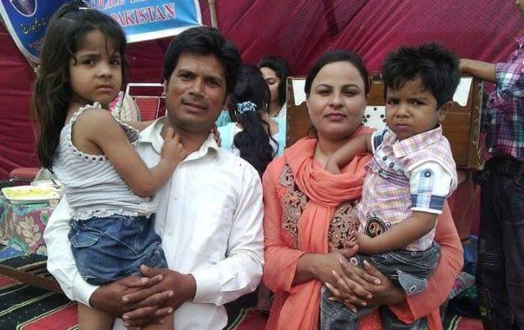
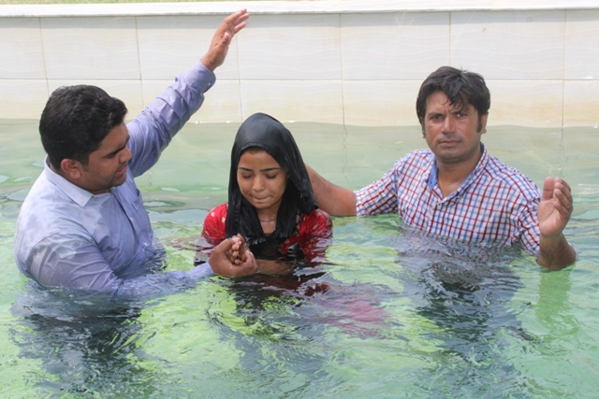
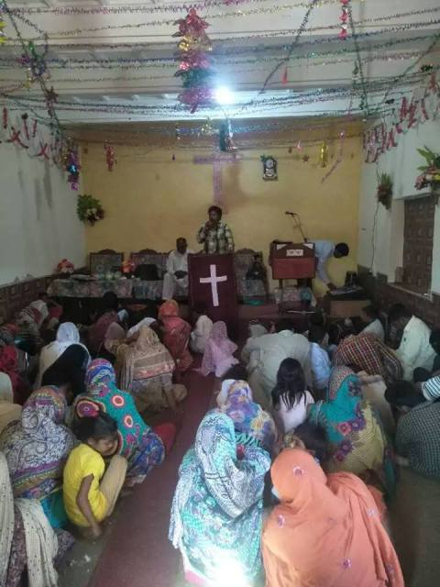
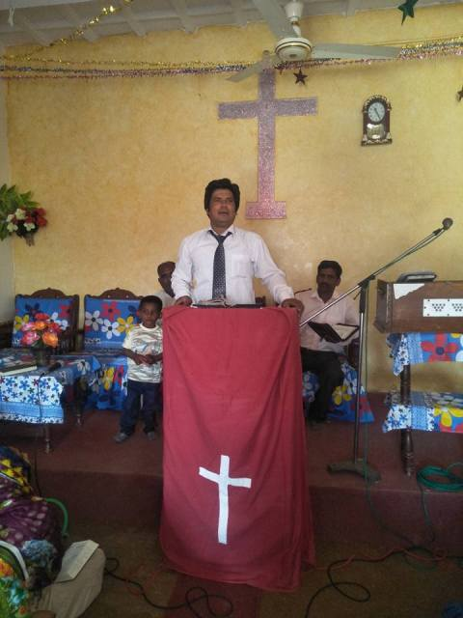
Pastor Nadeem Masih & family
Pastor Nadeem Masih ministering at village Lakho Daar district Lahore with 30 families in a rented house church. We are praying for church building there.

Slide 9
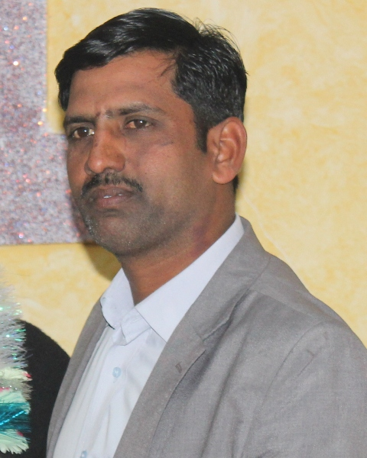
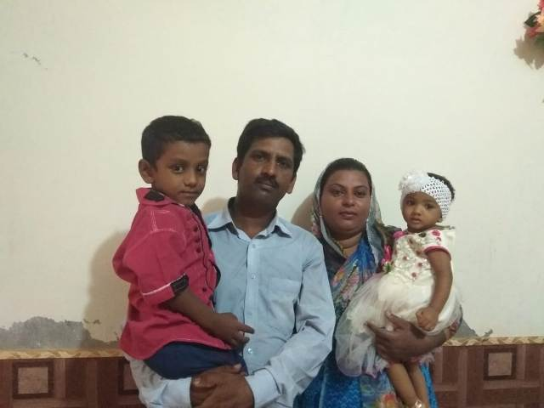
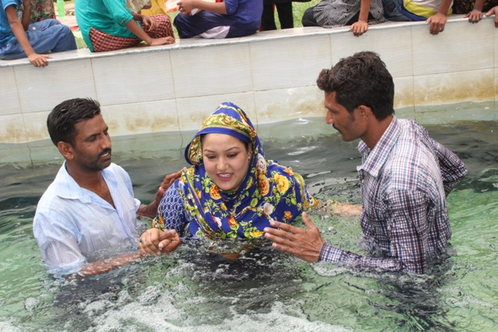
Pastor Shehbaz Younis & family
Pastor Shehbaz Younis is ministering at village Bhanee district Lahore since 2014 and have 35 families. We have church building there.

Slide 10
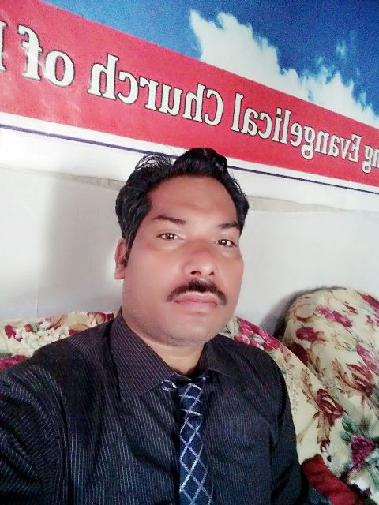
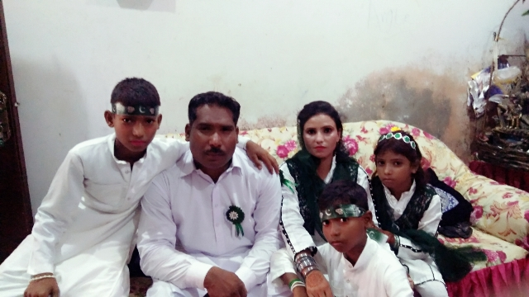
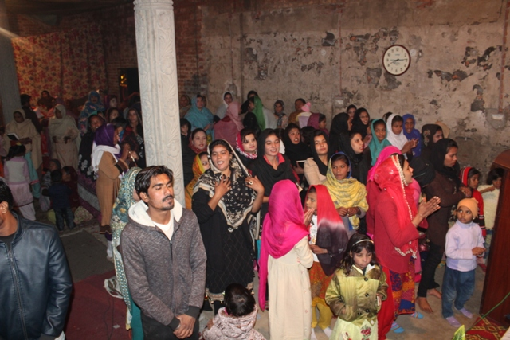
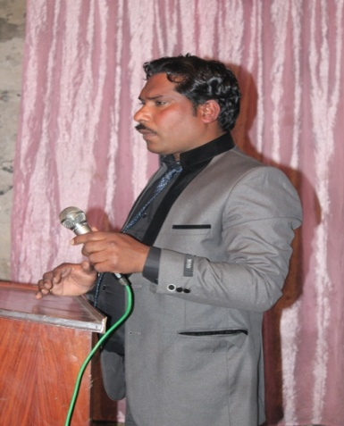
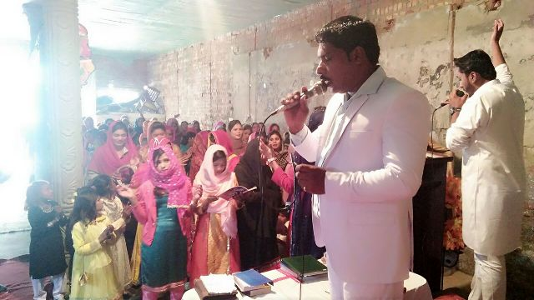
Pastor Tanveer Bashir ministering at village Mustifabad district Kasur since 2009 as assistant pastor with 45 families. The church building is under construction.( need widows, doors, and roof sealing,
Pastor Tanveer Bashir & family

Slide 11
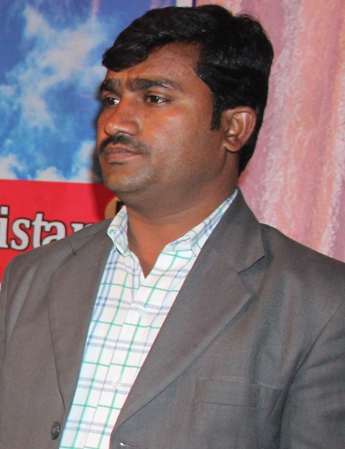
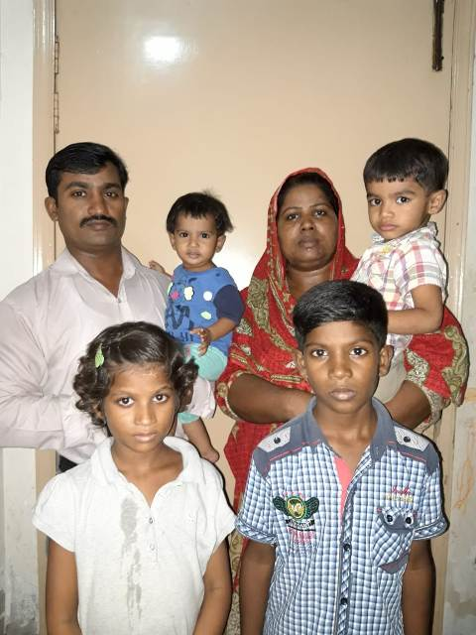
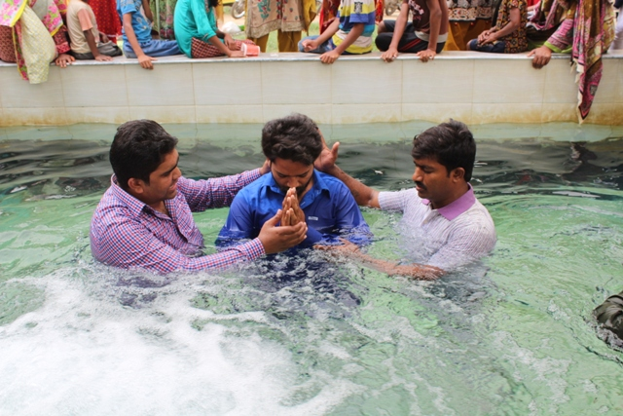
Pastor Fiaz Masih is ministering at village Dera Chahel, Lahore since 2012 in the house church with 18 families. We are praying for the church building.
Pastor Fiaz Masih gill

Slide 12
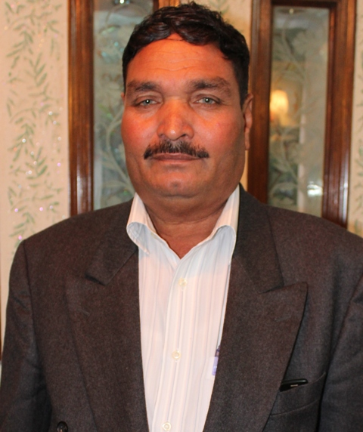
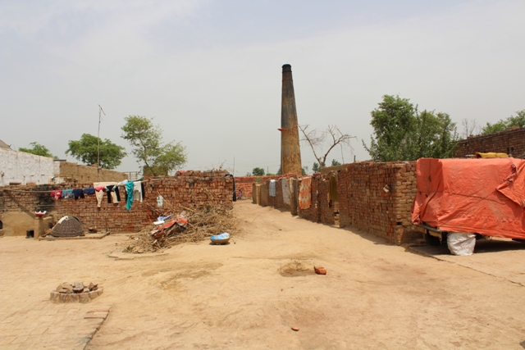
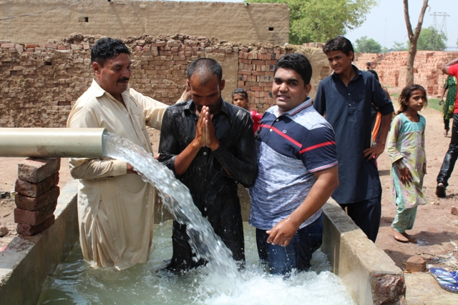
Pastor Nazir Masih ministering at village Vadana Brick Kiln at district Kasur since 2014 with 14 families and they worshiping the God in a house church. The building is dedicated by the owner of the brick kiln.
Pastor Nazir Masih

Slide 13





Pastor Mehboob Alam & family
Pastor Mehboob Alam is ministering at Youhannabad Colony, Lahore since
2016 with 32 families in a rented church building.

Slide 14





Pastor Baddar Munir is ministering at “ Asif Town” Lahore in a rented building with 20 families.
Pastor Baddar Munir & Family

Slide 15


Pastor Irfan Khushi ministering at village Bharo k Cheema district Gujranwala with 15 families
Pastor Irfan Khushi & family

Slide 16







Pastor Ilyas Masih Sindhu & family
Pastor Ilyas Masih Sindhu is ministering at village “Bahoo Chack district Gujranwala since 2014 with 28 families in the church building.

Slide 17



Pastor Samson Maqbool & family
Pastor Samson Maqbool is ministering at village “Sanda Chistanan district Kasur since 2013 and have 18 families and church building is under construction (without roof and doors, windows)

Slide 18



Pastor Hamayou Javed yet (Bechalor) and will marry in Feb, 2019 is ministering at village “Raani kay” district Gujranwala with 18 families. They have the land for church but yet not building, we are praying for building.
Pastor Hamayou Javed

Slide 19


Dear brothers and sisters, We heartily request you please make a room in your heart and hold LEOM for the monthly financial support to 17 Pastors ministering at villages, and rural areas of the Pakistan to reaching the lost and win them for the kingdom of God. Feel free to write us for further information of LEOM and contact us:
Prayer & Partnership
Pastor Samuel Sadiq
Founder & Chairman
Head Office: House # 189 Block A/01 Hamza Town, Opposite Youhannabad, Ferozepur Road, Lahore 54600- Pakistan
Phone# +92 423 545 7393 Email:livingevan07@gmail.com Cell # +92 324 984 5012
Bank Detail:
Title : Living Evangelism Outreach Ministries Church of Pakistan
Address: MCB Bank Limited
1603- Asif Town Branch- Lahore
20-kilometer Feroze pur Road, Lahore- Pakistan
A/C 0527552511000313
Swift Code: MUCBPKKA

